Slide 1















Project presentation
BIKE FACTORY WEB APPLICATION
Presented by
Sumaiya Akther Mahbuba & Mashiat Islam
Project Supervisor
Razorshi Prozzwal Talukder
(Lecturer North East University Bangladesh )

Slide 2

Origin of the creative idea
The idea for the Bike Factory Motorkleding and Accessories web application originated from the need to create an efficient, admin-centric platform for cycling and motorbiking enthusiasts. The goal was to provide the admin with extensive control through a comprehensive dashboard for managing user accounts, monitoring activities, and handling roles and permissions. Real-time notifications, detailed activity logs, and analytics ensure prompt responses and data-driven decision-making.
Dynamic product management allows the admin to easily add, update, or remove products, maintain optimal inventory levels, and manage promotions and discounts. Seamless user interaction is facilitated through comments, inquiries, and real-time purchase status updates, ensuring a responsive and engaging user experience. This approach ensures an efficient, robust online platform that benefits both the admin and users.

Slide 3
•HTML •CSS
•JS
Frontend
Used Tools
Backend
•Express JS
•Node JS
The project boasts a dynamic web interface crafted with HTML, CSS, and JavaScript, robust backend operations powered by Express.js and Node.js, and secure data management with MySQL.
Database
•My SQL

Slide 4
Key Features
01
02
03
Seamless user interaction is facilitated through direct engagement features. Users interact with the admin by leaving comments and asking questions. Additionally, users can submit purchase requests and receive real-time status updates, ensuring transparency and timely communication throughout the purchasing process. These functionalities contribute to a user-friendly experience that prioritizes interaction and responsiveness.
The platform provides admins with a user-friendly interface for dynamic product management, allowing seamless addition, updating, and removal of products with detailed specifications. Real-time inventory tracking and alerts optimize stock levels, while strategic promotions and discounts enhance user engagement and sales strategies, ensuring a responsive online shopping experience.
Notification System: Real-time alerts for new registrations, purchase requests, and inquiries ensure prompt admin responses, enhancing operational efficiency.

Slide 5
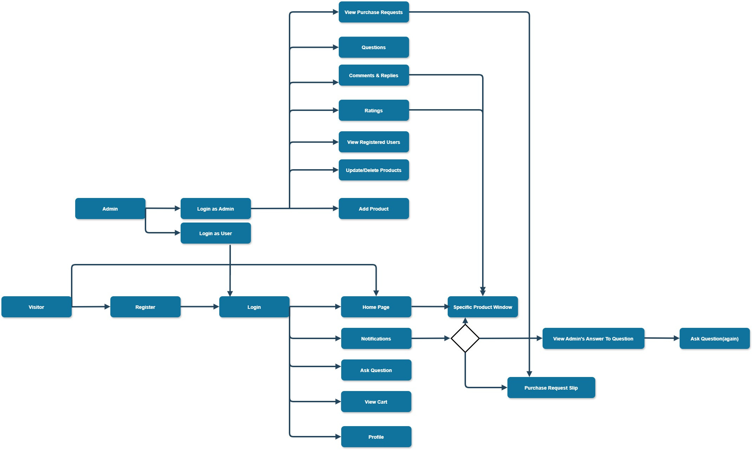
Web
Structure Diagram

Slide 6
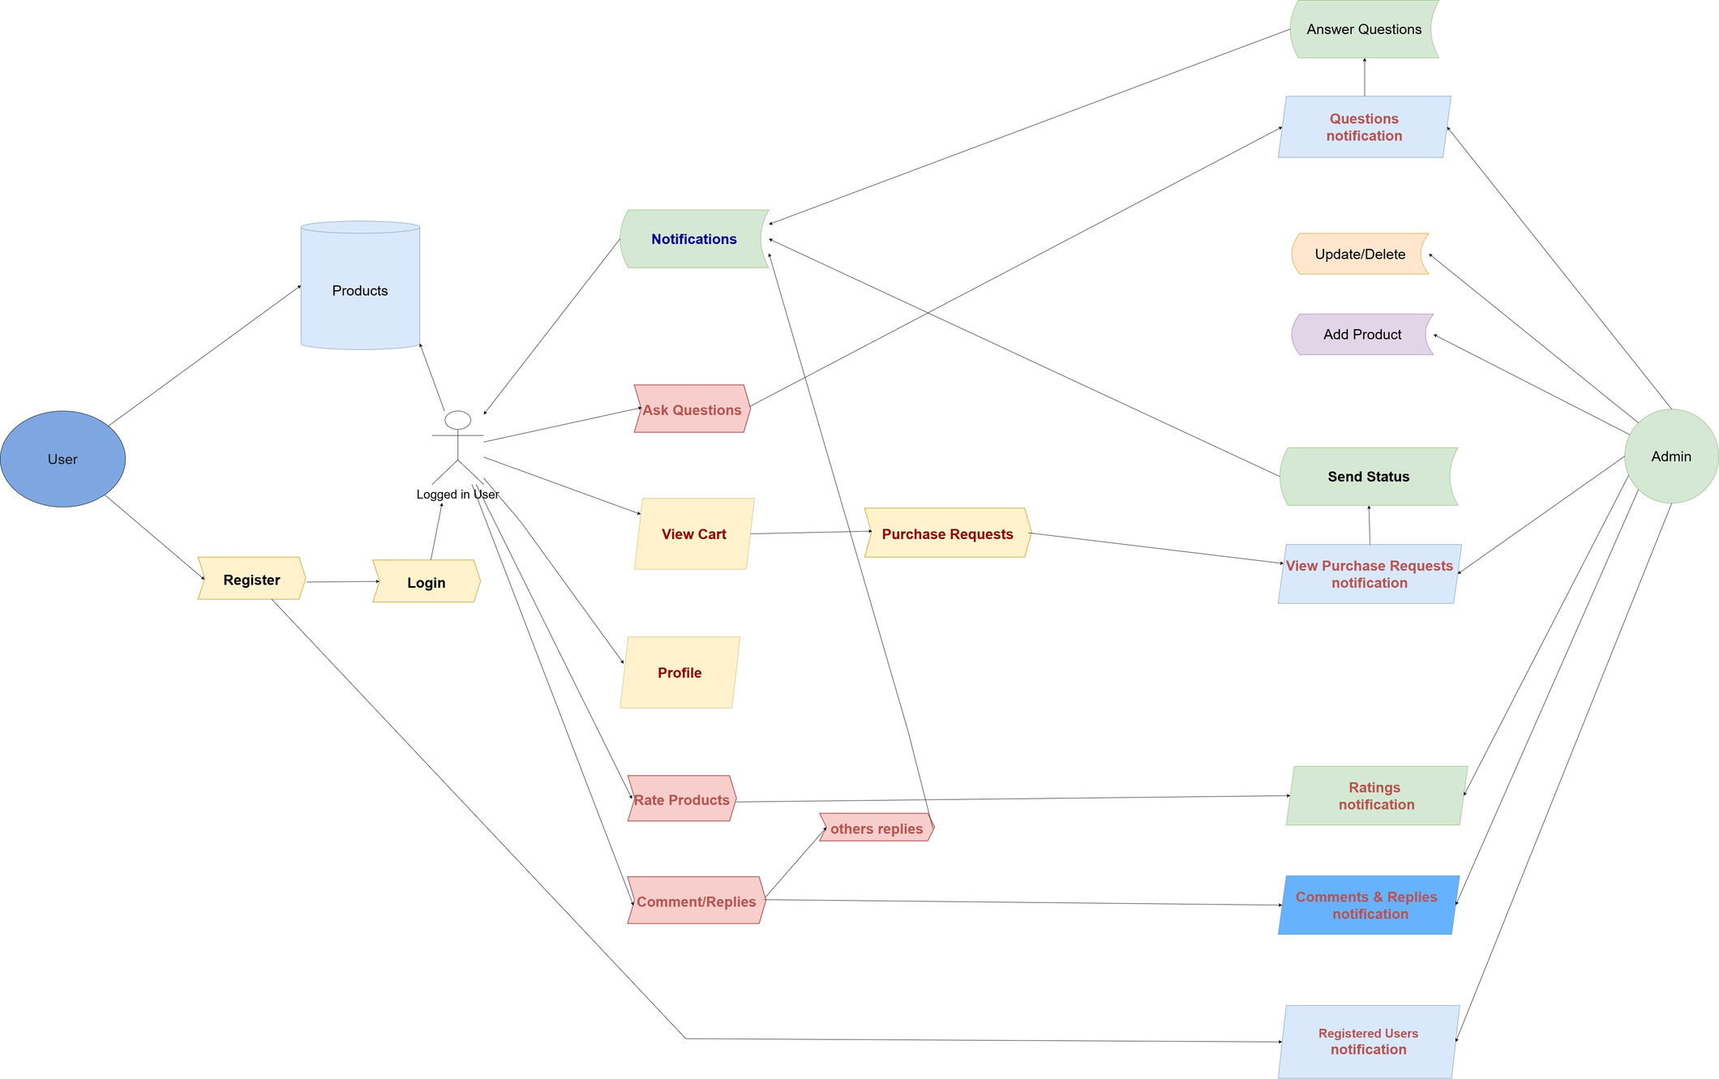
System Architecture

Slide 7
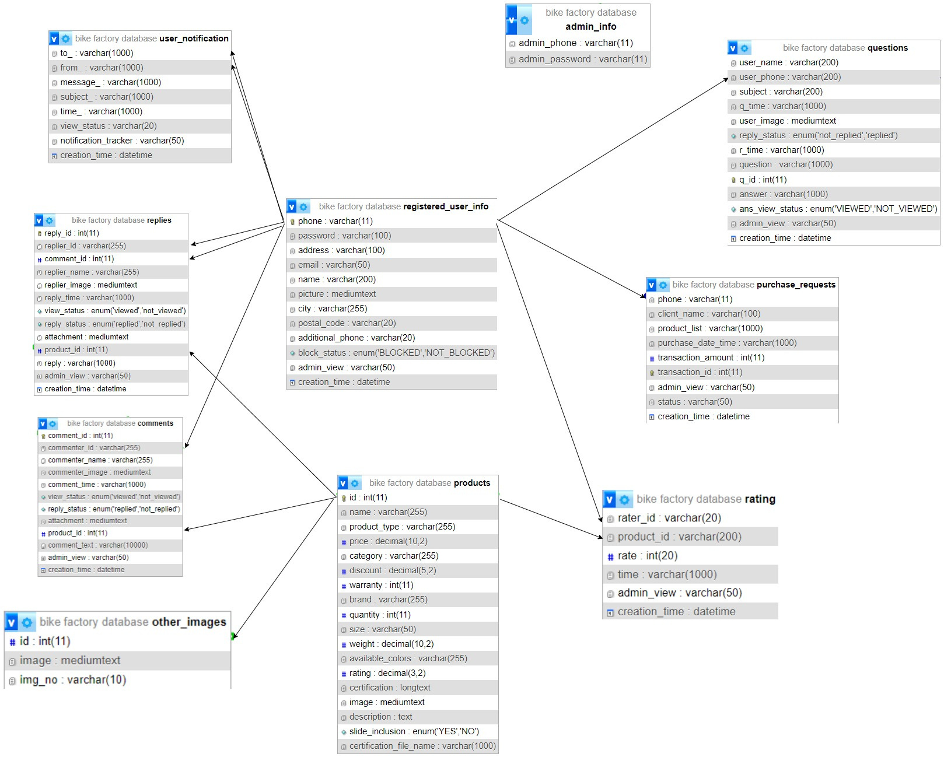
ER DIAGRAM

Slide 8

Let’s view
THE KEY PARTS OF
THE WEB APPLICATION

Slide 9
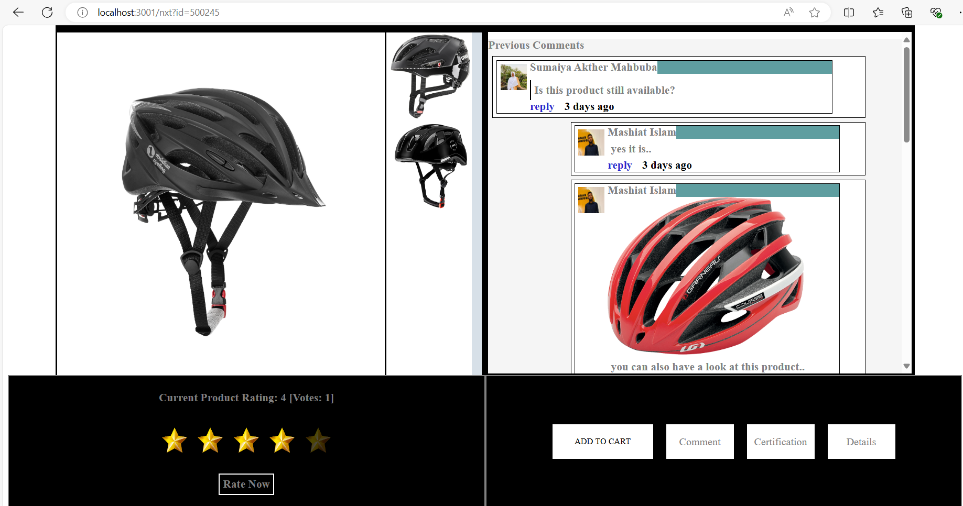
Users enjoy real-time interactions

Slide 10
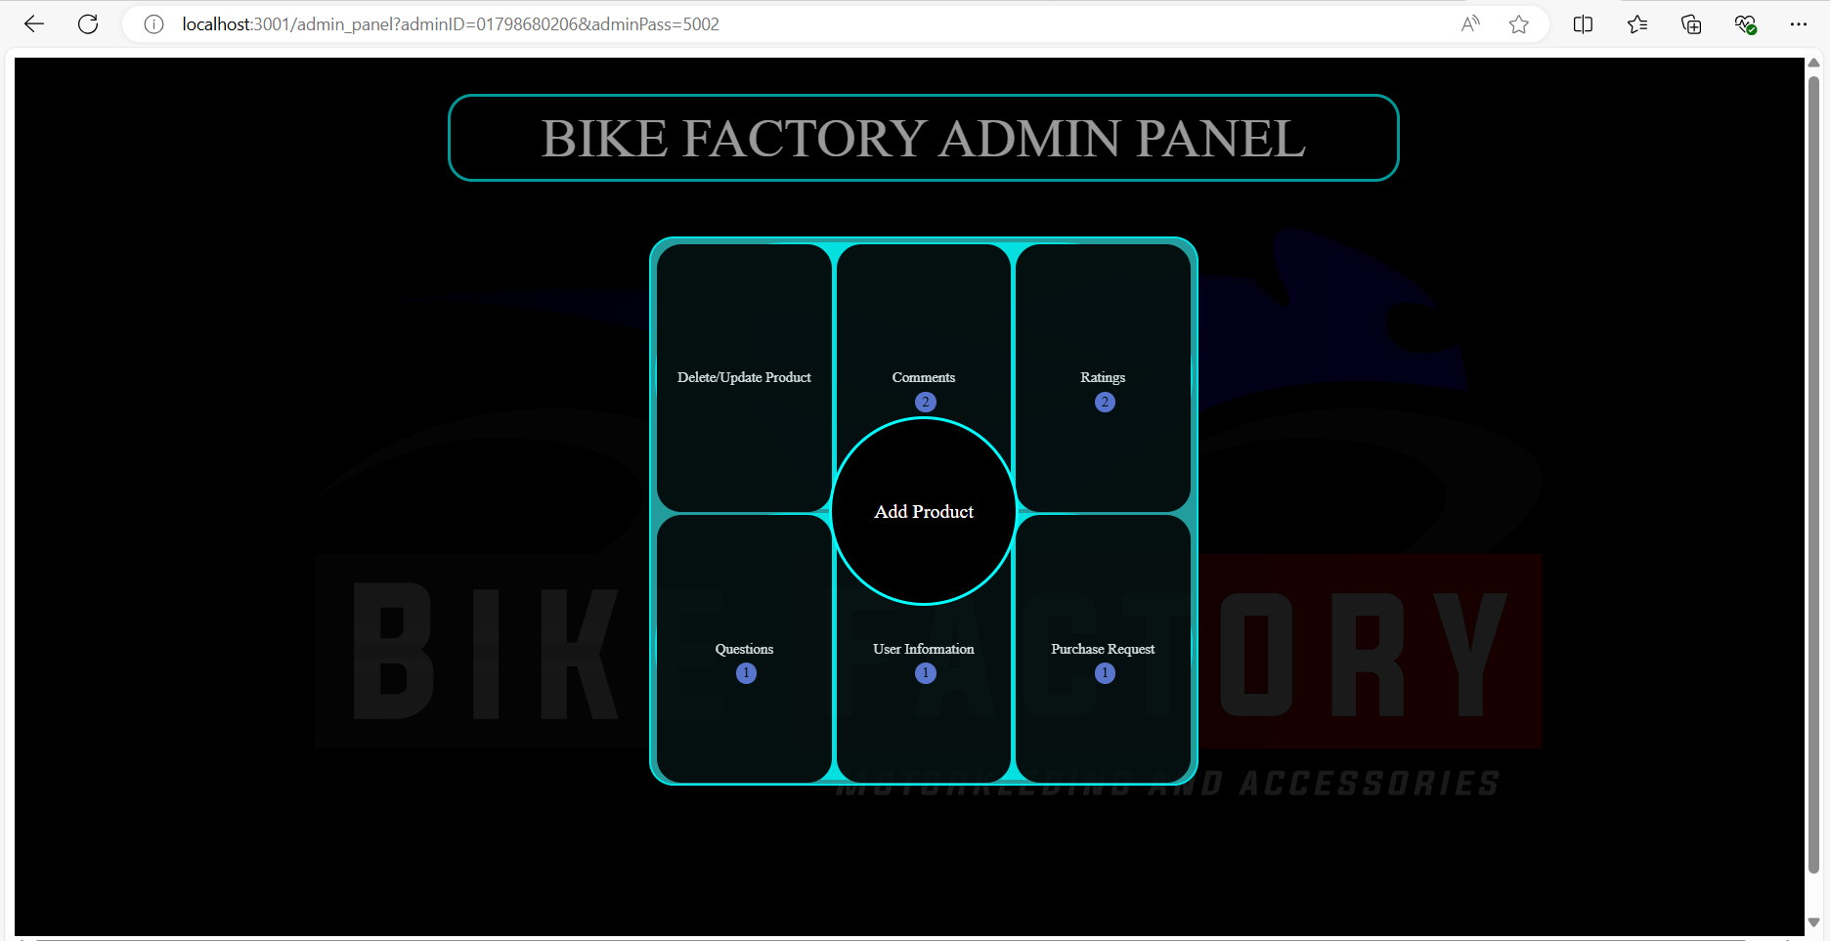
Admin monitoring all interactions from one point

Slide 11
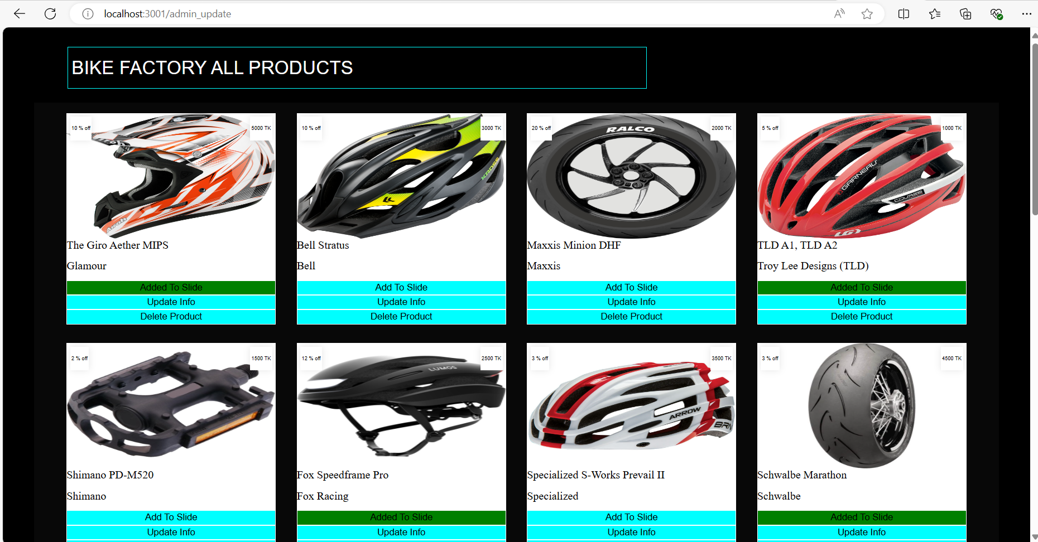
Admin can update information of pushed products

Slide 12
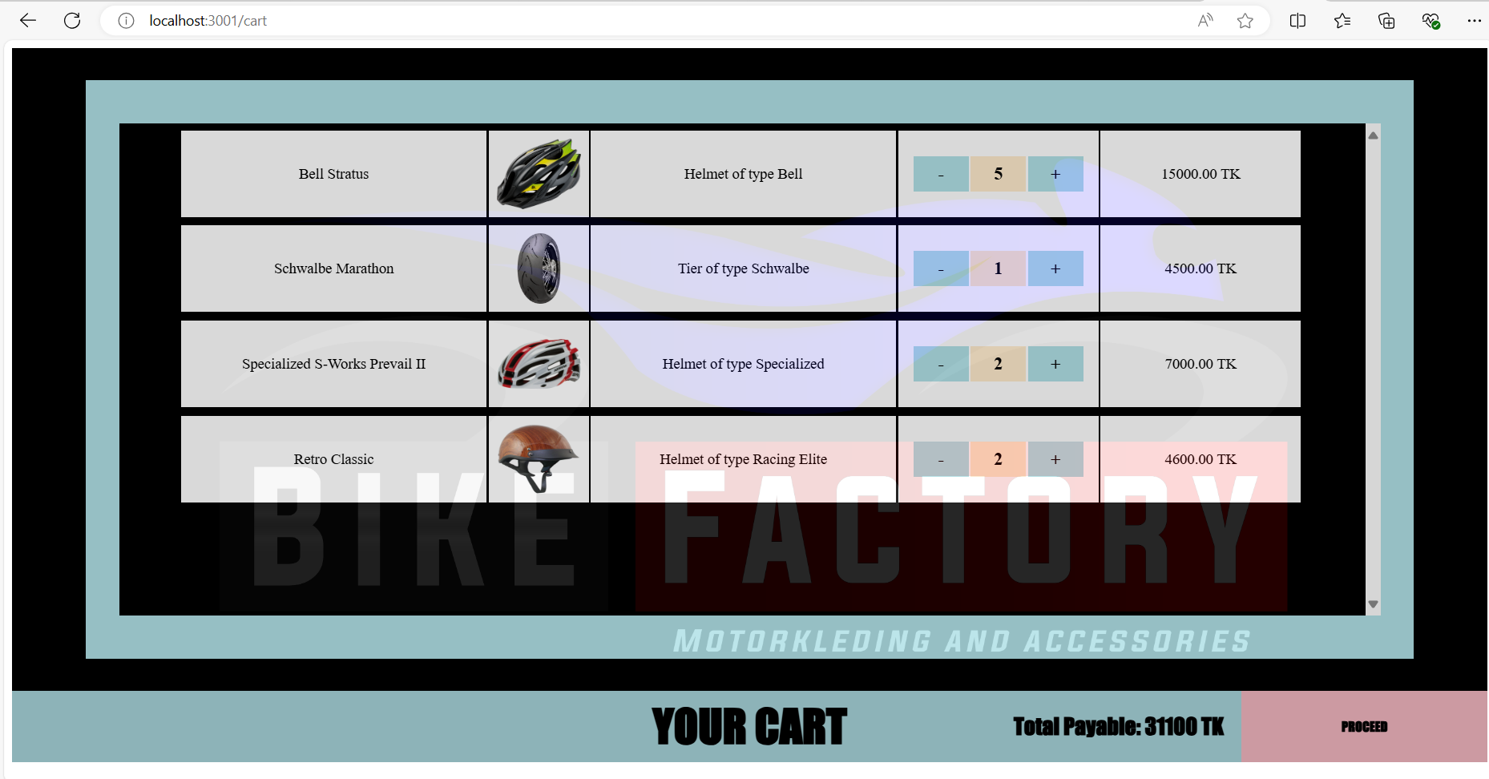
Users adding desired items to the cart to send purchase request to the admin

Slide 13
There are
many more

Slide 14
visit
www.bikefactory.com
demo link
Thank you

